Slide 1
Achilles Tendinopathy Rehabilitation Device
Rachel Jacobsohn
Brianna Hajek and Eshan King
BME 401A Section 1
10/11/17

Slide 2
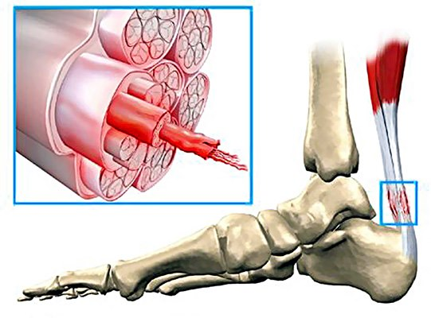
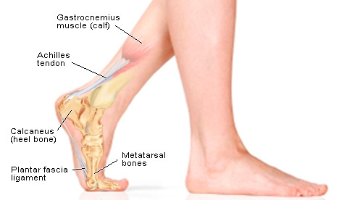
The Achilles Tendon and Achilles Tendinopathy
Notes:
The Achilles tendon is a tough band of fibrous tissue that connects the calf muscles to the heel bone, and it is the largest and strongest tendon in the body.
Unfortunately, this makes the Achilles very vulnerable to injury because of the high tensions placed on it. It is also often subject to a limited blood supply.
Achilles tendinopathy develops as a result of repeated tiny injuries called microtrauma to the Achilles tendon. After each injury, the tendon does not heal properly, and damage to the Achilles build up over time.
Several factors are thought to cause these microtrauma:
Overuse or rapidly increasing the intensity and frequency of training
Inappropriate footwear
Poor training technique
Training on sloped surfaces
Symptoms include:
Pain
Stiffness
Swelling/inflammation

Slide 3
Affected Population and Market
Approximately 6 in 100 inactive people develop Achilles tendinopathy.
The incidence rate of Achilles tendinopathy in runners is 9% with a lifetime risk of 52%.
Notes:
Approximately 6 in 100 inactive people develop Achilles tendinopathy at some point in their lifetime
However, the probability of developing Achilles tendinopathy is much higher in athletes or those who train regularly and do a lot of exercise.
The incidence of Achilles tendinopathy in elite runners is 9% and they have a lifetime risk of 52%.
While there are treatment options available for Achilles tendinopathy, little reliable experimental or clinical scientific work has be done to study these options. Furthermore, there are serious drawbacks associated with the current treatments. Many of them are ineffective, take a long time to be effective, are expensive, or require access to a physical therapy or athletic training facility. As a result the is a significant market for a device that can address these issues.
https://www.marathoninvestigation.com (running)
https://therunningbug.com/fitness/injuries/the-ultimate-guide-to-beating-achilles-pain-how-to-prevent-treat-and-recover (girl with hurt ankle)

Slide 4
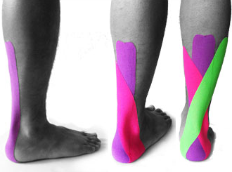
Existing Solutions
Eccentric Heel Drop Exercises
Ice/Heating
Taping
Notes:
The existing treatment options can be categorized as conservative or operative, with operatives approaches being reserves as a last result. Presented here are a few of the most commonly used methods for treating Achilles tendinopathy.
Ice/Heat - This is self explanatory, the treatment method involves applying ice or a heating to the injured Achilles.
Inexpensive, widely available
Only treat the symptoms of Achilles tendinopathy, not the underlying causes
Eccentric Heel Drop Exercise
(To do these stand on the bottom step of a set of stairs with your heels hanging over the edge of the step. The person then rises up onto his toes, lifts their unaffected leg while slowly lowering the heel of the affected leg.
Several advantages of this treatment are that it is inexpensive, it can be performed almost anywhere, and it does not require any special equipment of professional assistance.
However, these exercises can be painful and take a long time to be effective
Taping
Kinesiology tape is a thin, elastic, cotton strip with an acrylic adhesive that is almost identical to human skin.
There is much anecdotal support for the effectiveness of taping.
However, it is expensive, requires the assistance of a physical therapist or trainer, and is not reusable
http://www.aidmyachilles.com/pulled-achilles/ice-vs-heat-for-your-achilles-tendon.php (ice/heat)
https://www.vivehealth.com/blogs/resources/achilles-tendon-brace (compression)
http://myphysiosa.com.au/how-to-tape-achilles-posterior-impingement/ (taping)
http://www.anatomy-physiotherapy.com/en/articles/musculoskeletal/lower-extremity/ankle/514-effectiveness-of-the-alfredson-s-protocol-compared-with-a-lower-repetition-volume-protocol-for-mid-portion-achilles-tendinopathy-a-randomized-controlled-trial (eccentric heel drops)
http://aspenlasers.com/laser-therapy-surgery-laser-for-podiatry/ (laser light therapy)

Slide 5
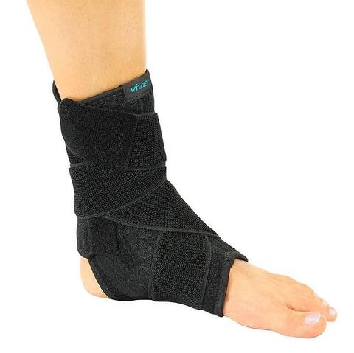
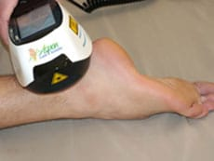
Existing Solutions (cont.)
Compression
Laser Light Therapy
Notes:
Two other common treatment options are compression and Laser Light Therapy.
Compression is usually administered in the form of a brace as pictured on the left.
External compression therapy is supposed to increase blood flow to the injured region, thus accelerating the healing process.
Unfortunately, there is little evidence that this actually works especially given the fact that achilles tendinopathy does not follow a normal inflammatory/healing process
Laser Light Therapy involves the directing monochromatic light to the Achilles with a laser.
Some studies have been conducting showing the benefits of LLT, but data still remains limited.
Furthermore, this treatment option is expensive and unavailable to a people without access to a physical therapist or an athletic trainer.
There are several other approaches for managing Achilles tendinopathy that have not been shown because they are used far less frequently for a variety of reasons such as cost, accessibility, reliability, or because they cause extreme discomfort for the user.

Slide 6
Need Statement
There is a need for a midpoint Achilles tendinopathy treatment device targeting runners with Achilles pain that reduces the pain experienced while running or walking and reduces the time spent rehabilitating post injury.
Notes:
Based on our research of the problem we have crafted the following need statement… There is a need for a midpoint Achilles tendinopathy treatment device targeting runners with Achilles pain that reduces the pain experienced while running or walking and reduces the time spent rehabilitating post injury.

Slide 7
Project Scope
Objective
To reduce pain and accelerate healing in runners with Achilles tendinopathy.
Severity
Treat all levels of Achilles tendinopathy severity.
Additional Criteria
Accessible
Portable
Reusable
User friendly
Inexpensive
Notes:
As addressed in our need statement, the purpose of our device is to reduce pain and accelerate the healing of Achilles tendinopathy in runners. The device will be able to treat athletes whose achilles tendinopathy ranges from mild to chronic. Other requirements for our design are that it be accessible, inexpensive, portable, reusable, and user friendly.

Slide 8
Specifications
Metric | Value
Accessible | Does not require access to a physical therapist or athletic training facility
Portability | Lightweight Small enough to travel
Reusable | Does not have to be replaced after a single use
User friendly | Easy to assemble and operate
Inexpensive | Initial cost to the user <$40
Notes:
Based on the criteria for our device laid out by our client, Mary Tarzon, we have identified the following design specifications.
The specifications on this slide are those addressed in our project scope. A person should not need access to a physical therapist or athletic training facility to use the device and it should not be so expensive that cost prevents athletes from using it. People should be able to easily travel with the device, operate it easily, and use it multiple times.

Slide 9
Specifications
Metric | Description
Durable | Maintains mechanical properties and functionality over time
Hygienic | Appropriate parts can be cleaned and sanitized
Comfortable | Discomfort is not a limiting factor in the use of the device
Aesthetic | Appearance should not intimidate the user
Notes:
Based on the criteria for our device laid out by our client, Mary Tarzon, we have identified the following design specifications.
The specifications on this slide are those addressed in our project scope. A person should not need access to a physical therapist or athletic training facility to use the device and it should not be so expensive that cost prevents athletes from using it. People should be able to easily travel with the device, operate it easily, and use it multiple times.

Slide 10
Specifications
Metric | Description
SAFETY | Incapable of doing harm to the user
Notes:
Based on the criteria for our device laid out by our client, Mary Tarzon, we have identified the following design specifications.
The specifications on this slide are those addressed in our project scope. A person should not need access to a physical therapist or athletic training facility to use the device and it should not be so expensive that cost prevents athletes from using it. People should be able to easily travel with the device, operate it easily, and use it multiple times.

Slide 11
Individual Responsibilities
Brianna
Manage the shared email account
Update the shared Google calendar
Mechanical design/modeling
Rachel
Submit assignments to Blackboard/instructors
Oversee website development
Electrical design/modeling
CAD design
Eshan
Responsible for ordering parts and equipment
Communicate with the client, Mary Tarzon
Software/coding
Notes:
In addition to the individual responsibilities listed on the slide there are also tasks that we will all work on together including:
Preliminary research
Brainstorming
Overall device design and assembly
Crafting of reports and presentations

Slide 12
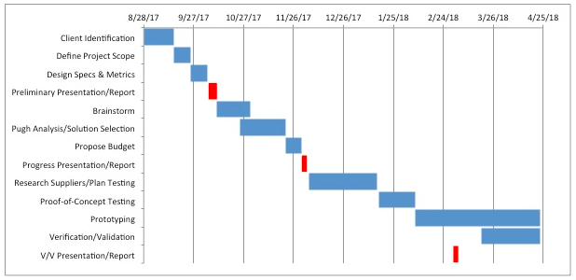
Design Schedule
Notes:
To be successful and avoid falling behind, our team created a schedule including target dates for important milestones. Looking forward, we will spend the remainder of October brainstorming different solutions and have one chosen by the end of the month.
Now, I’d be happy to answer any questions that you have.

Slide 13
References
Maquirriain, Javier. "Achilles tendon rupture: avoiding tendon lengthening during surgical repair and rehabilitation." The Yale journal of biology and medicine 84.3 (2011): 289.
Perl, Daniel P., Adam I. Daoud, and Daniel E. Lieberman. "Effects of footwear and strike type on running economy." Med Sci Sports Exerc 44.7 (2012): 1335-43.
Lopez, Roberto Gabriel L., and Hong-Geun Jung. "Achilles tendinosis: treatment options." Clinics in orthopedic surgery 7.1 (2015): 1-7.
Kvist, Martti. "Achilles tendon injuries in athletes." Sports Medicine 18.3 (1994): 173-201.
Brandt, Ken. “Types of Achilles Tendon Injuries.” Achilles Tendon
de Jonge, Suzan, et al. "Incidence of midportion Achilles tendinopathy in the general population." Br J Sports Med 45.13 (2011): 1026-1028.
Paavola, Mika, et al. “Current Concepts Review Achilles Tendinopathy.” The Journal of Bone and Joint Surgery, vol. 84A, no. 11, Nov. 2002, pp. 2062–2076.
Payne, Jacqueline. “Achilles Tendinopathy.” Patient, 2 June 2016.
Ingraham, Paul. “Icing for Injuries, Tendinitis, and Inflammation.” Pain Science, 2004.
“Should You Ice or Heat an Injury?” Southern California Orthopedic Institute.
Alfredson, H., and J Cook. “A Treatment Algorithm for Managing Achilles Tendinopathy: New Treatment Options.” British Journal of Sports Medicine, vol. 41, no. 4, 2007, pp. 211–216., doi:10.1136/bjsm.2007.035543.
Knobloch, Karsten, et al. “Eccentric Training Decreases Paratendon Capillary Blood Flow and Preserves Paratendon Oxygen Saturation in Chronic Achilles Tendinopathy.” Journal of Orthopaedic & Sports Physical Therapy, vol. 37, no. 5, 2007, pp. 269–276., doi:10.2519/jospt.2007.2296.
“Physio Works - Physiotherapy Brisbane.” How to Apply Kinesiology Tape

Slide 14
References (cont.)
Pysny, Ladislav, et al. “Kinesio Taping Use in Prevention of Sports Injuries During Teaching of Physical Education and Sport.” Procedia - Social and Behavioral Sciences, vol. 186, 2015, pp. 618–623., doi:10.1016/j.sbspro.2015.04.039.
Bassett, Kelly T, et al. “The Use and Treatment Efficacy of Kinaesthetic Taping for Musculoskeletal Conditions: a Systematic Review.” NZ Journal of Physiotherapy, vol. 38, no. 2, July 2010.
Knobloch, Karsten, et al. "Midportion achilles tendon microcirculation after intermittent combined cryotherapy and compression compared with cryotherapy alone: a randomized trial." The American journal of sports medicine 36.11 (2008): 2128-2138.Medco Sports Medicine Catalog 2017.”
Medco Sports Medicine, Medco Sports Medicine, 2017
Davis, John. “Achilles Tendonitis in Runners: A Degenerative Overuse Injury Best Treated with Eccentric Heel Drops.” Running Writings, 19 Nov. 2013.
Reddy, G. Kesava, Lisa Stehno‐Bittel, and Chukuka S. Enwemeka. "Laser photostimulation of collagen production in healing rabbit Achilles tendons." Lasers in surgery and medicine. 22.5 (1998): 281-287.
Kneebone, William J. "The Treatment of Achilles Tendonitis Using Therapeutic Laser." (2010).
Stergioulas A, Stergioula M, et al. “Effects of low-level laser therapy and eccentric exercises in the treatment of recreational athletes with chronic achilles tendinopathy.” Am J Sports Med, 2008;36(5):881–887.
Longo, Umile Guiseppe, et al. “Achilles Tendinopathy.” Sports Medicine and Arthroscopy, vol. 17, no. 2, June 2009.

