Slide 1
Group 16 Achilles rehab device Progress report
Eshan King
BME 401A 2017
12/04/2017

Slide 2
Project scope
Need statement and scope unchanged:
Objective
To reduce pain and accelerate healing in runners with Achilles tendinopathy.
Additional Criteria
Accessible
Portable
Reusable
User friendly
Inexpensive

Slide 3
Team responsibilities
Eshan
Interface with vendors, communicate with client, software design, research materials, preliminary drawings.
Rachel
Submit assignments to blackboard, oversee website design, electrical design, CAD design.
Brianna
Manage shared account, update google calendar, mechanical modeling, budgeting, sewing wearable components.
Shared
Preliminary research, brainstorming, device design and assembly, writing reports and presentations.

Slide 4
Changes to specifications
Cost
Cost to user $40 $60
Recurring costs eliminated to reflect scope.
Durability
Quantitative value: device must remain functional through reasonable use for at least one year.
Safety
“Incapable of inflicting harm” “Incapable of inflicting mechanical harm during reasonable use.”
Electrical components covered, biocompatible materials, no sharp edges, device temperature cannot harm users.
“Outcome” “Evidence of efficacy”
Support in scientific or clinical literature.

Slide 5
Other specifications (unchanged)
Portability – No perceptible change in gait (due to weight) if wearable.
Within airline carry-on requirements.
Accessibility – Available without prescription.
Regular access to PT clinic, athletic trainer, etc. is not necessary.
Could be sold at sporting goods or drug stores.
Usability – Does not require specialized training. Does not require user input or monitoring.
Fit – “One size fits all” or available in a variety of sizes.
Reusability – Does not have to be replaced after every use.
Comfort – Discomfort is not a limiting factor in the use of the device.
Simple assembly – Assembled by the user and reader to use in 30 seconds or less.
Hygiene – appropriate parts can be sanitized.
Aesthetics – appearance should not intimidate the user.
Power source – has enough power to last the duration of treatment.

Slide 6
Solution analysis
Most important design metrics (Pugh chart score of 10):
Safety
Portability – important for scope and need statement.
Accessibility – important for scope and need statement.
Deadline (feasibility).
Moderately important design metrics (Pugh chart score 6-8):
Usability
Cost
Fit
Reusabiilty
Comfort
Evidence of efficacy
Simple assembley.
Durability.

Slide 7
Solution analysis
Lowest weighted design metrics (Pugh chart score of 1-5):
Hygiene.
Aesthetics.

Slide 8
Design alternatives
Robotic assistive device (45.6%)
Mechanically active “exoskeleton” to reduce strain on Achilles.
High weight, high cost, unrealistic given the deadline.
Potential to be unsafe during normal operation.
Automatic stretch machine (48.3%)
Substantial support in clinical literature (eccentric exercises).
Reusable and durable.
Not portable, expensive, unrealistic given the deadline.
Electric foot/ankle bath (52.5%)
Foot sized bath – passes gentle electrical current through Achilles.
No clinical support, low portability, uncomfortable.

Slide 9
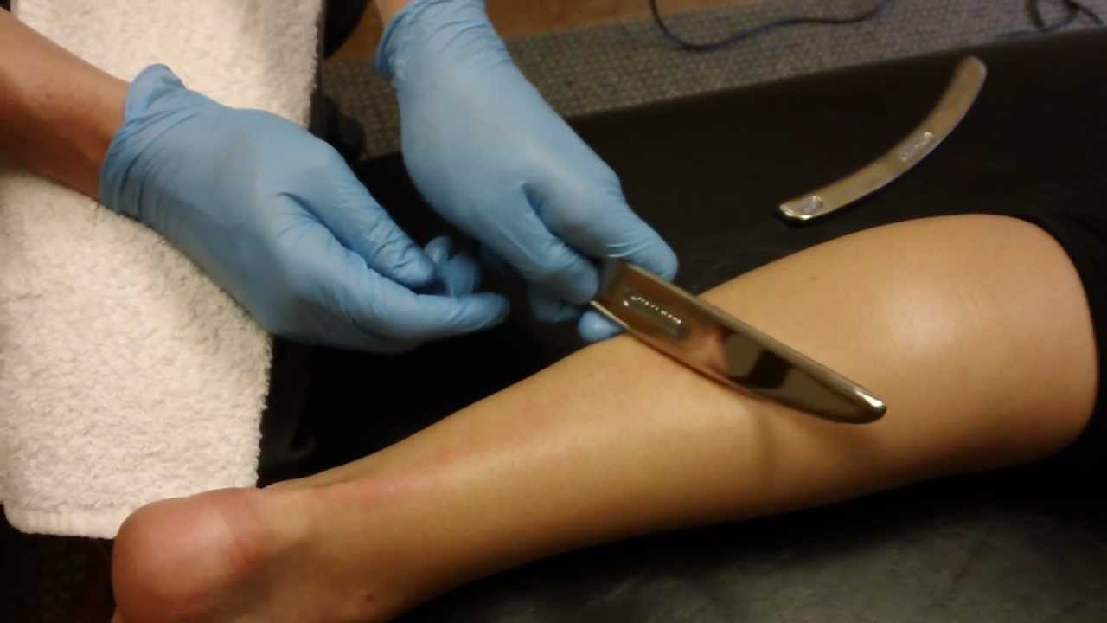
Design alternatives
Wearable E-Stim device (55.5%)
Electric current passed through Achilles tendon – fully automatic treatment.
Very little clinical support.
Wearable LLLT – laser light source (59.4%)
Substantial support in clinical literature.
Can be unsafe, difficult to complete by deadline (requires temperature feedback – challenging to fully automate), and would be costly.
Automatic Graston device (60.0%)
Automatically administer Graston therapy.
Graston is a dynamic, 3D technique – difficult to engineer a safe and effective device.

Slide 10
Design alternatives
Handheld LLLT device (61.7%)
Pen shaped – laser light source.
Two-step activation to mitigate risk.
Fit is not an issue.
Requires significant user input and training.
Potential to be unsafe and costly.
Wearable active massage device (63.0%)
Clinical research shows massage increases blood flow to targeted areas.
Reusable and accessible.
Extremely costly, difficult to transport, difficult to complete by deadline.

Slide 11
Design alternatives
Achilles cupping (63.4%)
Vacuum over Achilles surface.
User input required, low comfort, no support in clinical literature.
Heated tape (64.9%)
KT tape scaffold – worn while running.
Moderate support in literature.
Worn before and while running.
Not reusable, difficult to apply, and may be uncomfortable.

Slide 12
Design alternatives
Heating sock (72.9%)
Dosages of heat to the Achilles throughout the night.
Sync with user’s alarm.
Potential for overheating.
Challenging to complete by deadline given safety requirements.
Wearable LLLT – LED light source (74.6%)
Clinical support.
LED light source – must be worn for longer.
Fully automatic – dosage, timing, power levels. Could be worn at night.
Challenging to complete by deadline.

Slide 13
Design alternatives
Mechanical assistive Achilles device (79.9%)
Bio-inspired design.
Reduces net strain experienced by Achilles.
Simple design – cheap, safe, and accessible.
Less support in literature – novel solution.

Slide 14
Design alternatives
Other solutions that are unfeasible, outside of scope, or already on the market:
Wearable ultrasound stimulation – already on the market.
Wearable passive massage – unfeasible.
Topical Achilles ointment – unfeasible.
Oral pill for Achilles treatment – unfeasible.
High glucose bar – not a realistic treatment option.
Mobile repository of athletic training – outside scope.
Rehabilitation assistance app – outside scope.
Synthetic tendon prosthetic – outside scope.

Slide 15
Summary of solution analysis
Three solutions distinguished on the Pugh chart:
Mechanical assistive Achilles device, wearable LLLT with LED light source, wearable heating device.
Mechanical assistive device: slightly more portable, safe, and feasible considering deadline.
Low cost, simple assembly, and easy to keep clean.
Less support in literature – novel solution.
Support from Dr. Gregory Holtzman, Prof. of Physical Therapy at WUSTL.
Mechanical assistive device would help correct users’ running form – addresses underlying biomechanical causes of injury.

Slide 16
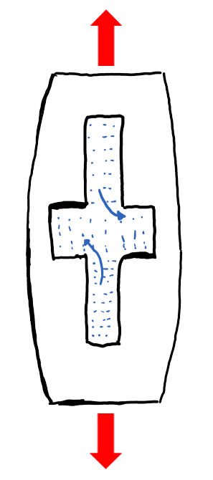
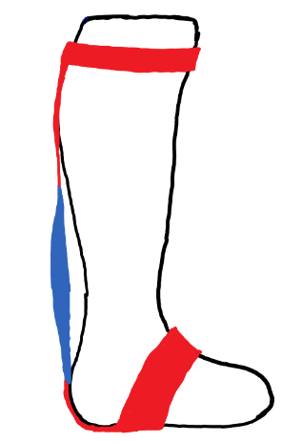
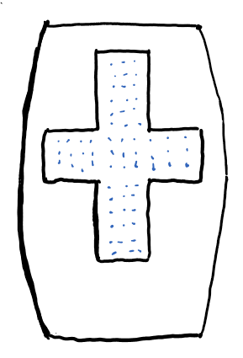
Overview of mechanical assistive device
A
B
Viscoelastic rubber component
Straps to transfer force to the foot and calf

Slide 17
References

